Slide 1

Automated Driving Systems - Co-Simulating Autoware with Simulink®
Group members:
Alperen Kıral
Daniyal Ahmed
Phuris Khunphakdee
Advisors:
Steve Schäfer (MathWorks)
Dr. Christoph Hahn (MathWorks)
1

Slide 2
Overview
Introduction
Previous Progress
Autoware Demo
Working Environment
Communication between ROS Nodes
Voxel Grid Filter
Future Work
Reference
2

Slide 3
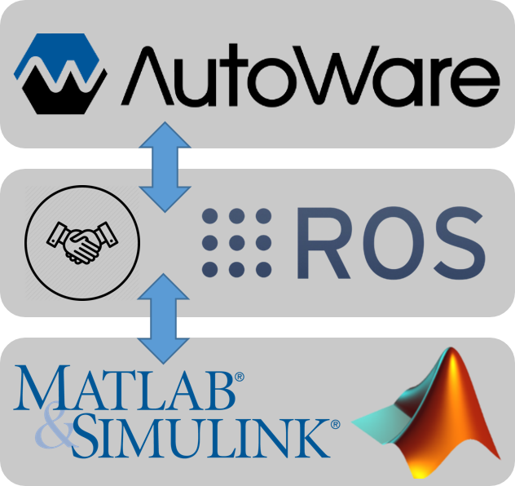
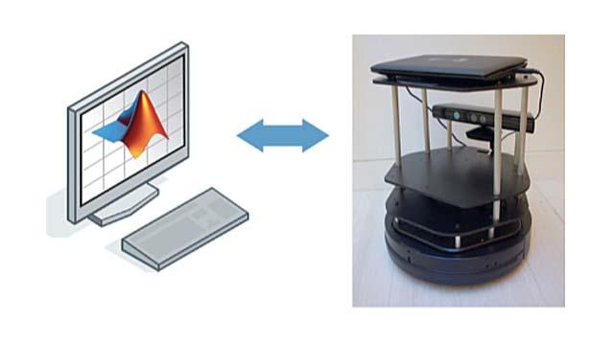
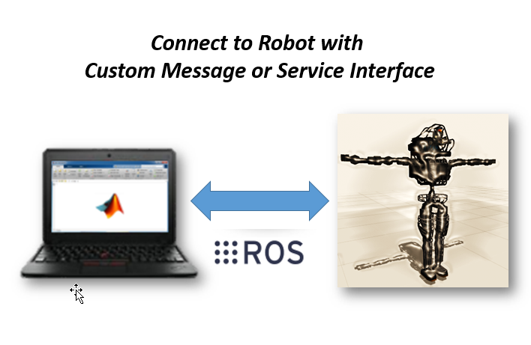
Introduction
The objectives of the project
To connect Autoware to MATLAB and Simulink using Robotics System Toolbox for co-simulation
To develop an automated-driving co-simulation example
Robotic System Toolbox
3

Slide 4

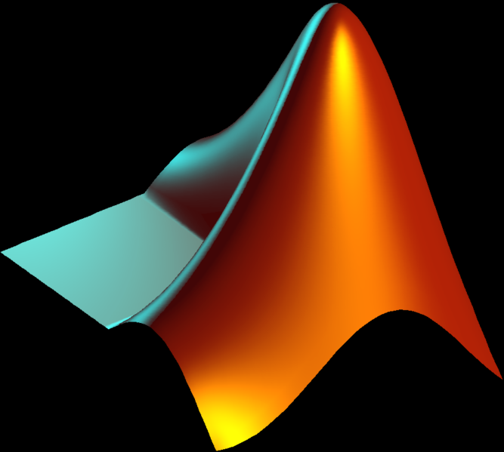



Previous Progress
Installation of required softwares and extensions
4

Slide 5
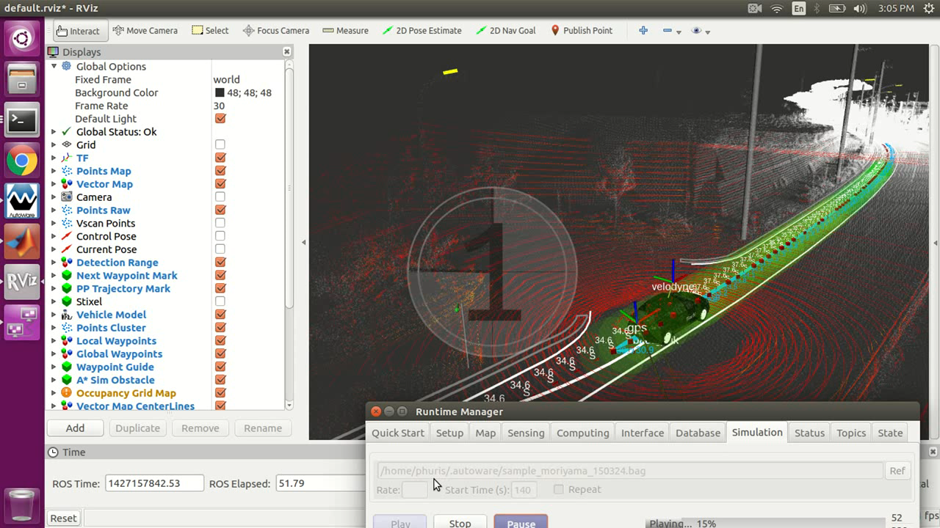
Autoware Demo
DEMO MAIN ELEMENTS
ROSBAG Data (LiDAR, GNSS)
Default Vehicle Model
Point Cloud
Vector Map
TF
Desired Modules
4

Slide 6
Working Environment
Possible Operating System Configuration:
Linux
Windows & Linux (Virtual Machine)
Windows + Linux (2 Separate Computers)
5

Slide 7
Communication between ROS Nodes
ROS Network
Topic
Image
Publish
Subscribe
Subscribe
Camera
Pedestrian Recognition
Traffic Light Recognition
Node 1
Node 2
Node 3
Notes:
Before going to our progress, I would like to give a short reminder about how ROS work.
ROS is a communication network of nodes which may represent certain functions.
They communicate to each other via topic as well as with the help of publisher and subscriber in each node

Slide 8
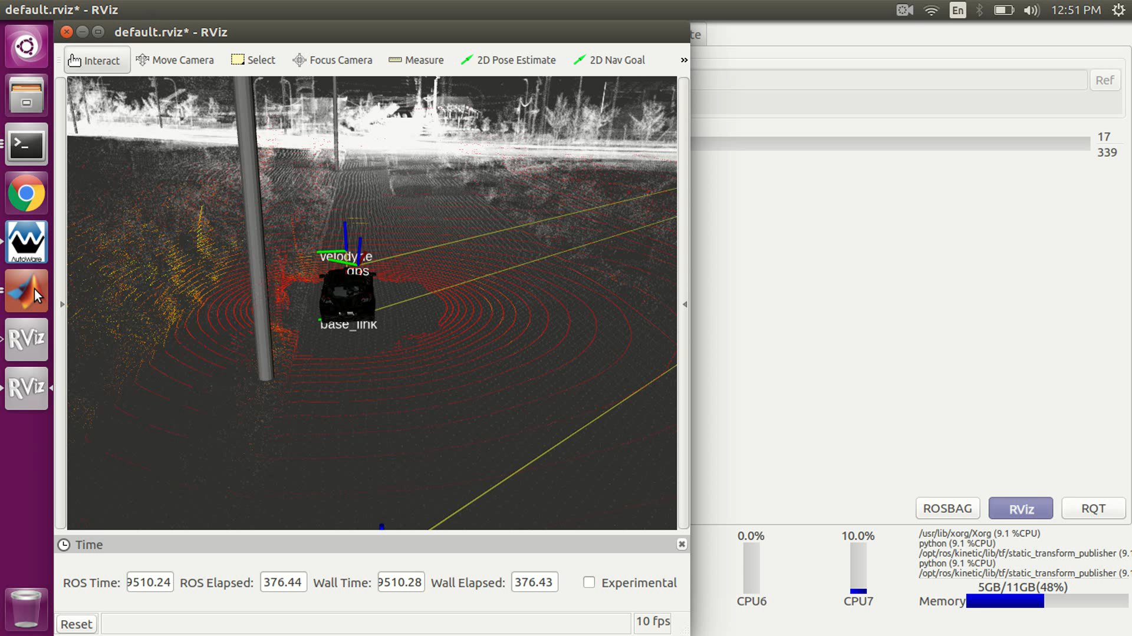
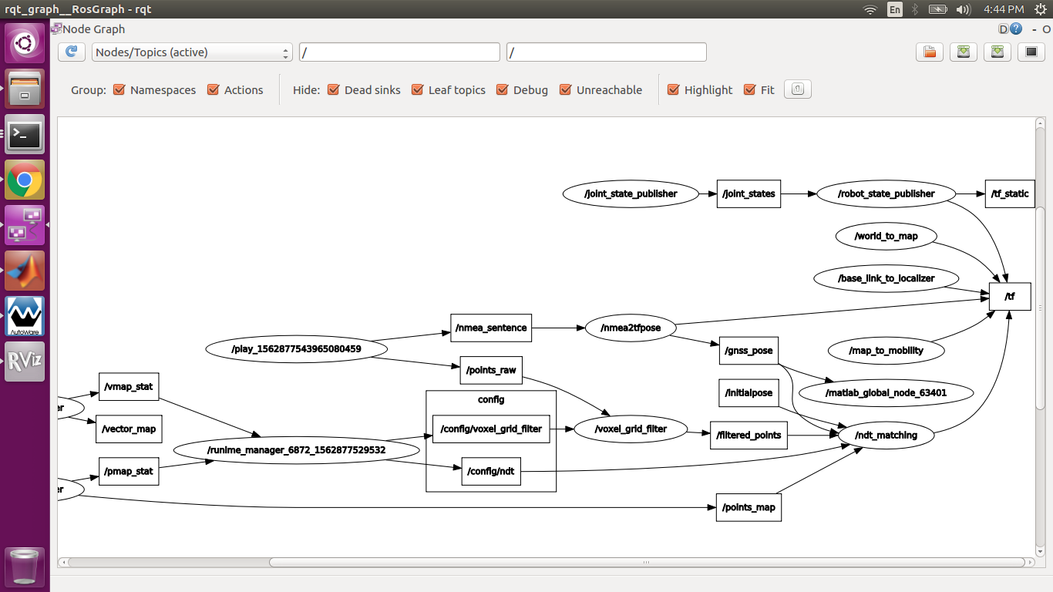
Communication between ROS Nodes
AUTOWARE - MATLAB
Localization with GNSS
MATLAB ROS Node
/gnss_pose
Subscribe
geometry_msgs/points
Car’s Position and Orientation from global navigation satellite system
geometry_msgs/Point for Position
geometry_msgs/Quaternion for Orientation
Notes:
Because Autoware is ROS based software. We can apply what can be done in ROS directly to autoware.
Here is an example that we have connected our ROS node to autoware node.
Our ROS node are develop by using MATLAB with the help of Robotic System Toolbox.
We created a subscriber that subscribe to gnss_poss topic and what we got from this topic are the instantaneous position and the orientation of the car. And then we write a callback function that plot the current position of the car as you can see in the video.
The massage type from the gnss_pose topic is of the type geometry_msgs/points

Slide 9
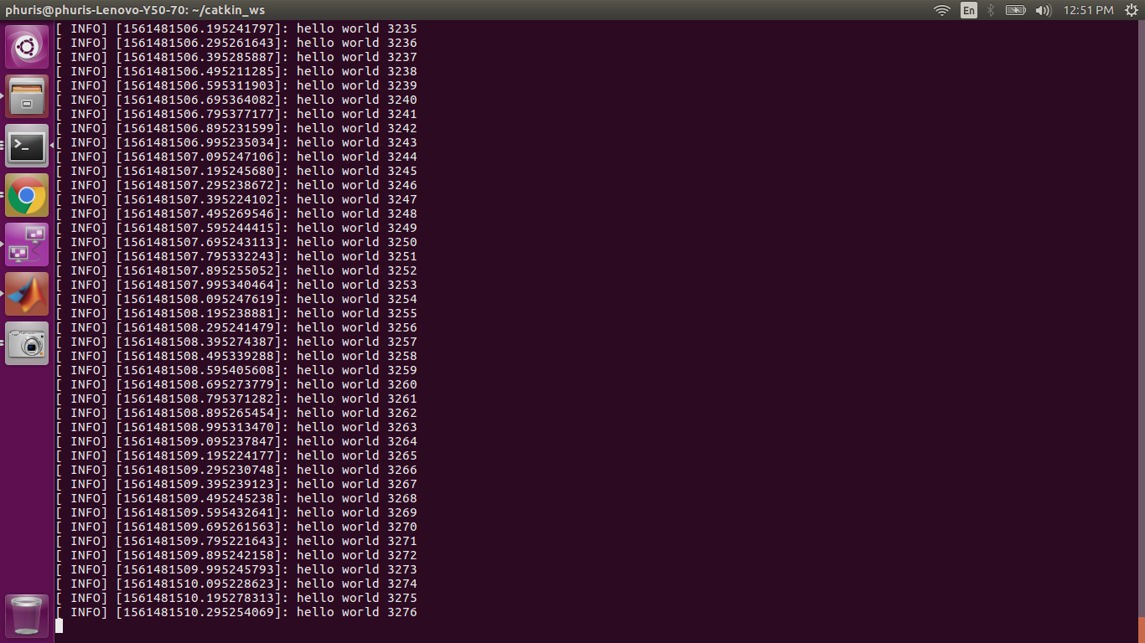
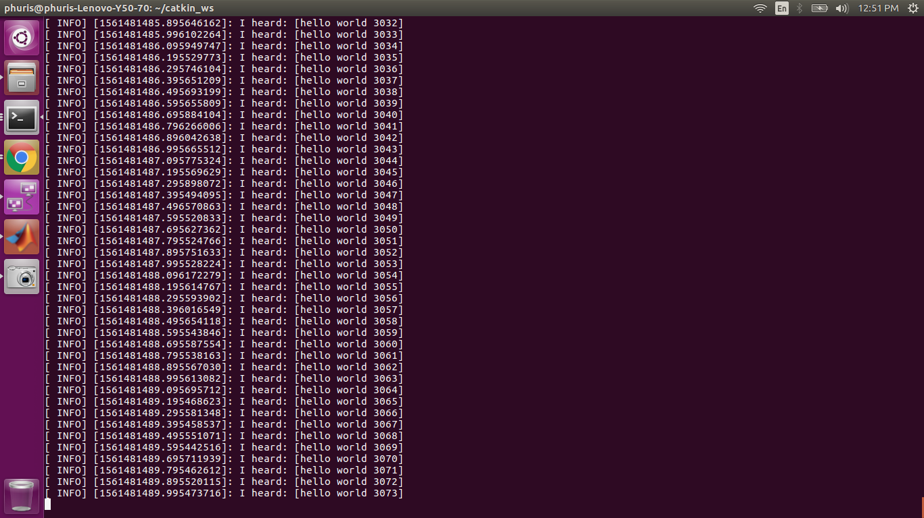
Communication between ROS Nodes
ROS - ROS
/talker
publish
/chatter
subscribe
/listener
Terminal window of talker
Terminal window of listener
Notes:
Before doing the example we have shown to you, we have tried to develop simple nodes that exchange data together in order to get more familiar with ROS.
The node talker publish the string message “hello world” to topic chatter as you can see on the left picture and the node listener subscribe message from this topic and print out what information that it receive as can be seen on the right picture.
This 2 nodes are developed using c++ language

Slide 10
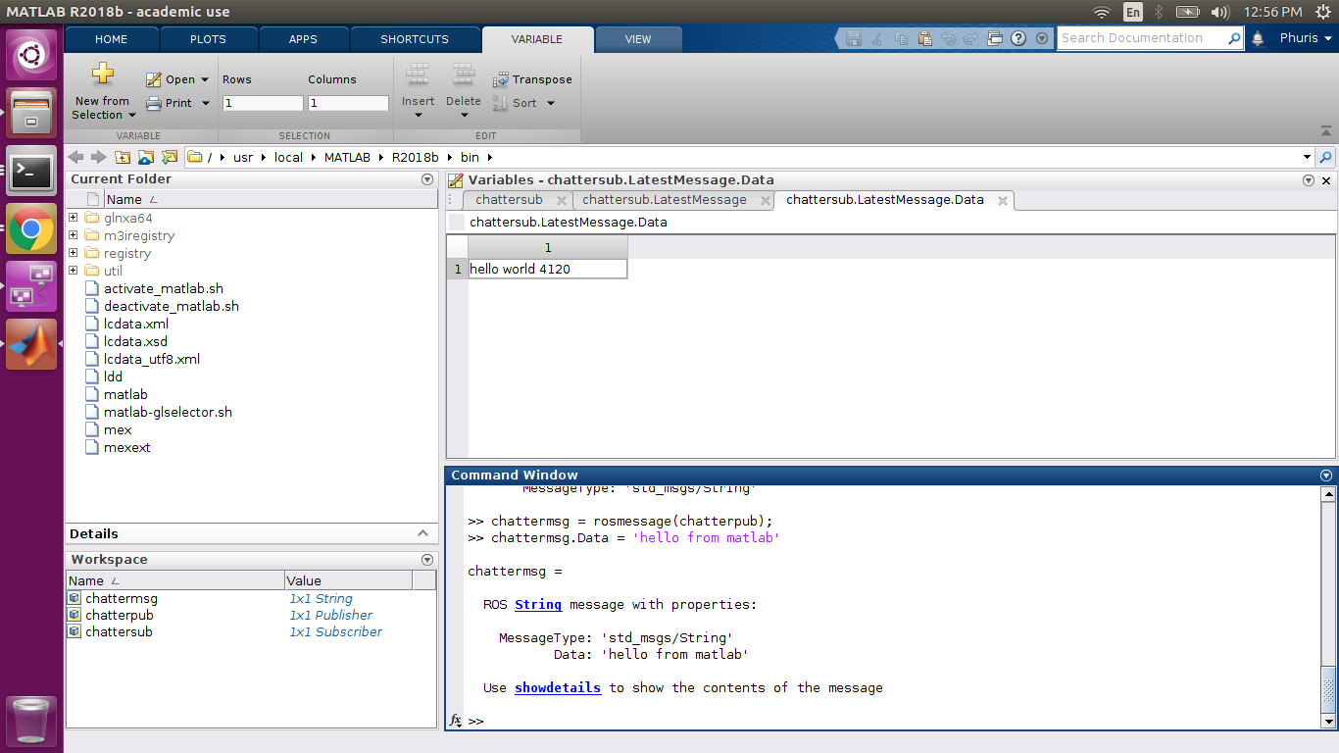
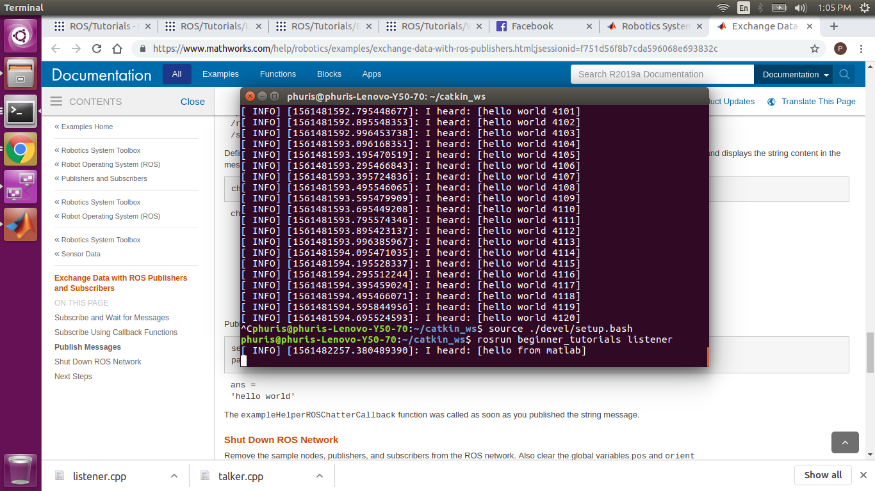
Communication between ROS Nodes
ROS - MATLAB
/talker
publish
/chatter
subscribe
/matlab_global_node_80598
Terminal window of talker
MATLAB Variable Data
Notes:
Then we move to create a ROS node in MATLAB and make it communicate to the C++ ROS node.
In this slide, the MATLAB ROS node subscribe the message from the topic chatter and we can see that, it can get the message from the topic.

Slide 11
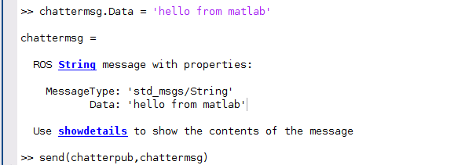
Communication between ROS Nodes
ROS - MATLAB
/matlab_global_node_80598
/chatter
/listener
publish
subscribe
Terminal Window of listener
MATLAB Command Window
Notes:
And then we tried the other way round. Using MATLAB ROS node as a talker and publish message to the listener node. And as you can see in the right picture, the message from our MATLAB ROS node appear in the listener node. So, this means that our MATLAB ROS node can be used in both direction.
Now Daniyal will talk about the Autoware toolbox that we also mentioned in the last time.

Slide 12
Voxel Grid Filter
There are three principle functionalities of Autoware
SENSING
COMPUTING
ACTUATING
Voxel Grid Filter

Slide 13
Voxel Grid Filter
Preprocessing
Digital 3D representations of the scanned objects
Incident to and reflected targeted pulsed lasers from the object
Filtering
LiDAR scanners
Point Cloud Data
Raw Point Cloud Data
Stereo-Cameras
Recognizes traffic lights and additional features of the surroundings
Voxel Grid Filter
Down-sampled point cloud data
Group of points contained in a cubic lattice to its centroids
Accurate Position
Normal Distribution Transform
Relative position between two point clouds

Slide 14
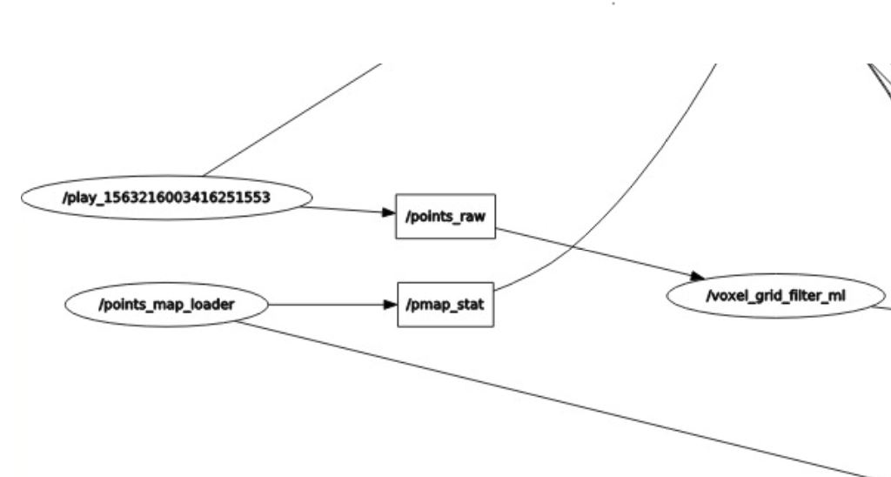
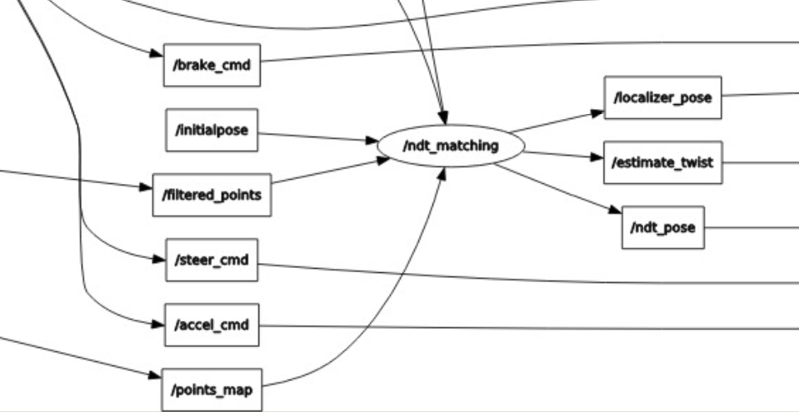
Voxel Grid Filter
MATLAB and AUTOWARE
Raw data
Voxel Grid Filter
Filtered data
Normal Distribution Transform

Slide 15
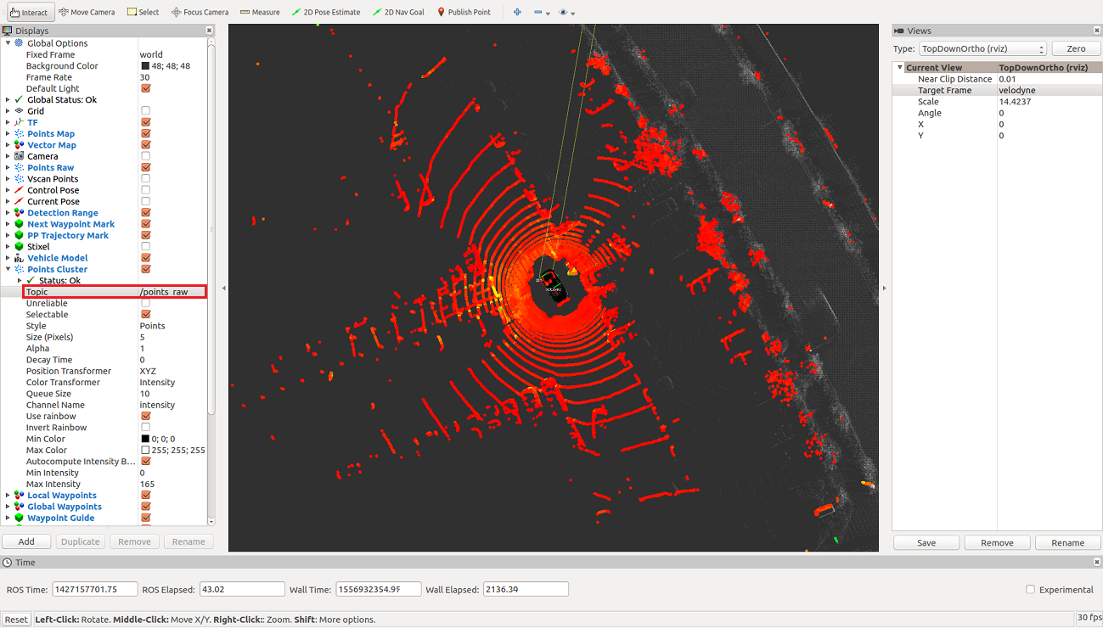
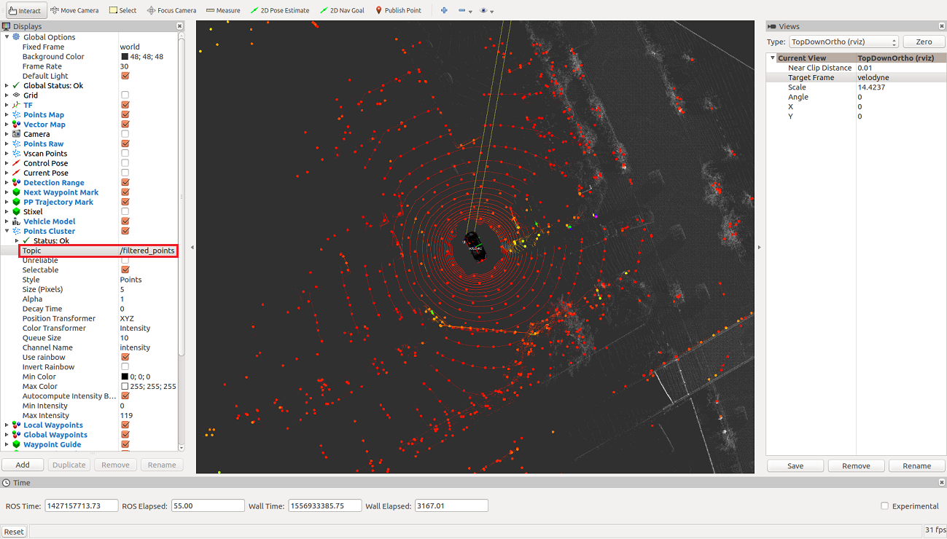
Voxel Grid Filter
Unfiltered(raw) point cloud data
Filtered (Down-sampled) cloud data

Slide 16
Future Work
1.
2.
SENSING
COMPUTING
ACTUATING
Voxel Grid Filter
DOCUMENTATION

Slide 17
References
Autoware Documentation. (n.d.). Retrieved May 12, 2019, from https://buildmedia.readthedocs.org/media/pdf/autoware/feature-documentation_rtd/autoware.pdf
Kato, S., Tokunaga, S., Maruyama, Y., Maeda, S., Hirabayashi, M., Monrroy, A., . . . Azumi, T. (2018). Autoware on board: Enabling autonomous vehicles with embedded systems. Proc. of ICCPS 2018. 1-11. doi:10.1109/ICCPS.2018.00035
MATLAB/Simulink sample code suite for Autoware. (n.d.). Retrieved May 13, 2019, from https://github.com/CPFL/Autoware_Toolbox
Source Build. (2019, March 18). Retrieved from https://github.com/autowarefoundation/autoware/wiki/Source-Build
Tokunaga, S., Horita, Y., Oda, Y., & Azumi, T. (2019). IDF – Autoware: Integrated development framework for ROS-Based self-driving systems using MATLAB/Simulink. ASD 2019. doi:10.4230/OASIcs.ASD.2019.3
How to Open and Edit Files and Folders in Ubuntu Desktop as an Administrator. (n.d.). Retrieved May 13, 2019, from https://vitux.com/how-to-open-and-edit-files-and-folders-in-ubuntu-desktop-as-an-administrator/

